Slide 1


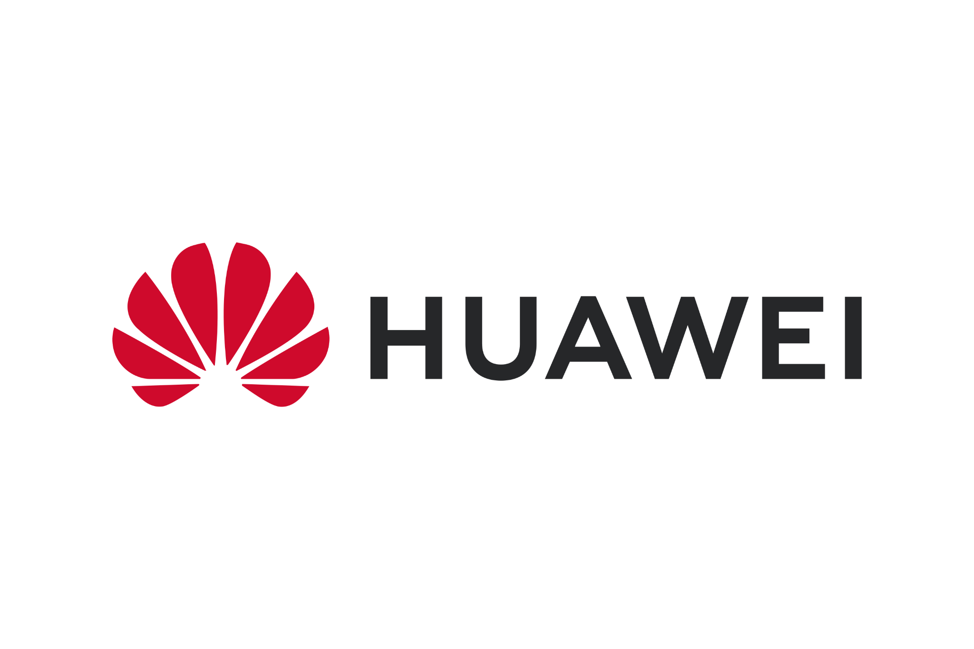

WebNN Experiment in
Shubham Gupta
Igalia WebEngine Hackfest 2026, June 16, Remote

Slide 2


Agenda: Exploring WebNN
The future of high-performance AI on the web
00
Traditional AI Flow
01
NPUs in Flagship Devices
02
WebNN
03
WebNN: Unlocking
04
Benefits over Standalone Web or Native ML Models
05
Usage
06
A Little Experiment
07
WebNN Components in Servo
08
Similar Projects

Slide 3

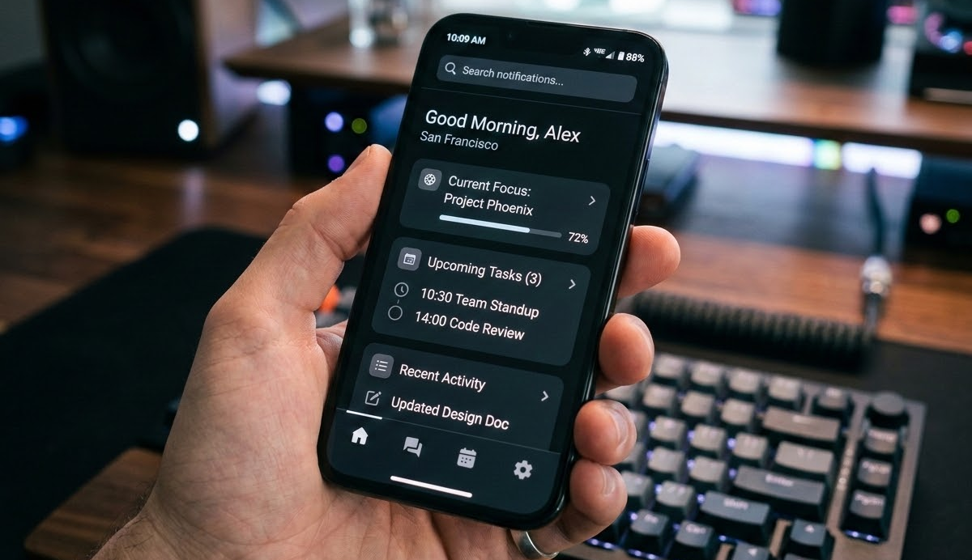

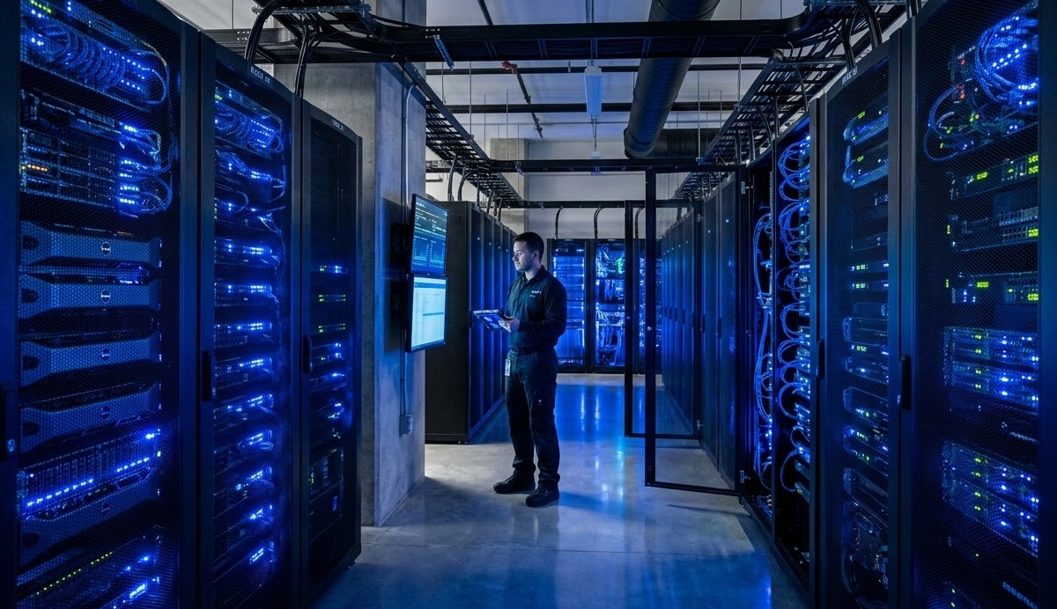
Traditional AI Workflow
How AI computations typically flow to remote servers
STEP 01
STEP 02
STEP 03
Data Input
User provides data (image, text, voice) to the web browser interface.
Cloud Transit
Data is transmitted over the network to a high-performance remote server.
Inference
The remote server performs AI inference and sends the result back to the user.

Slide 4
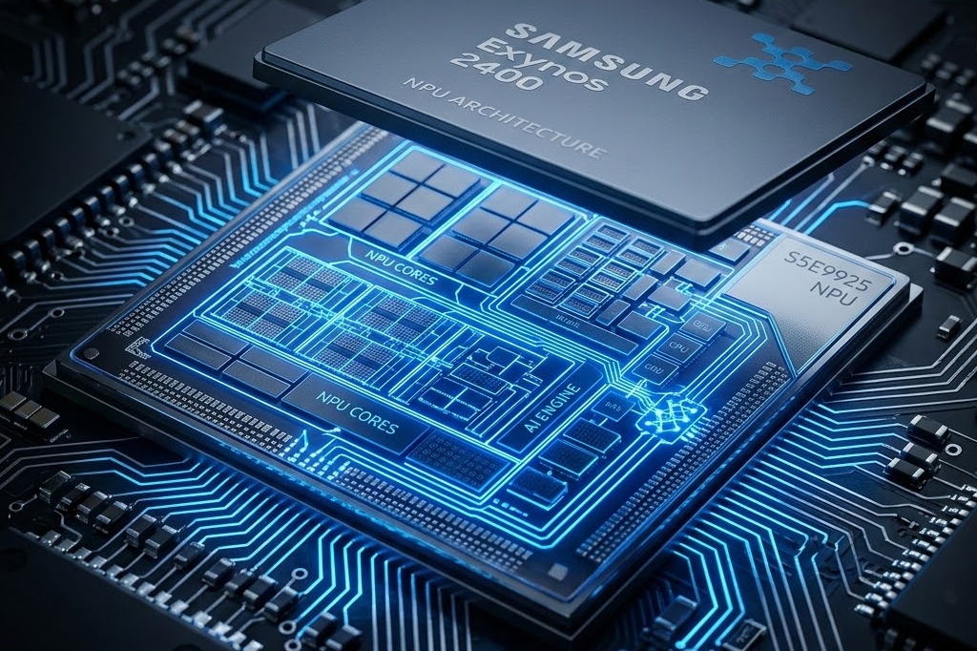
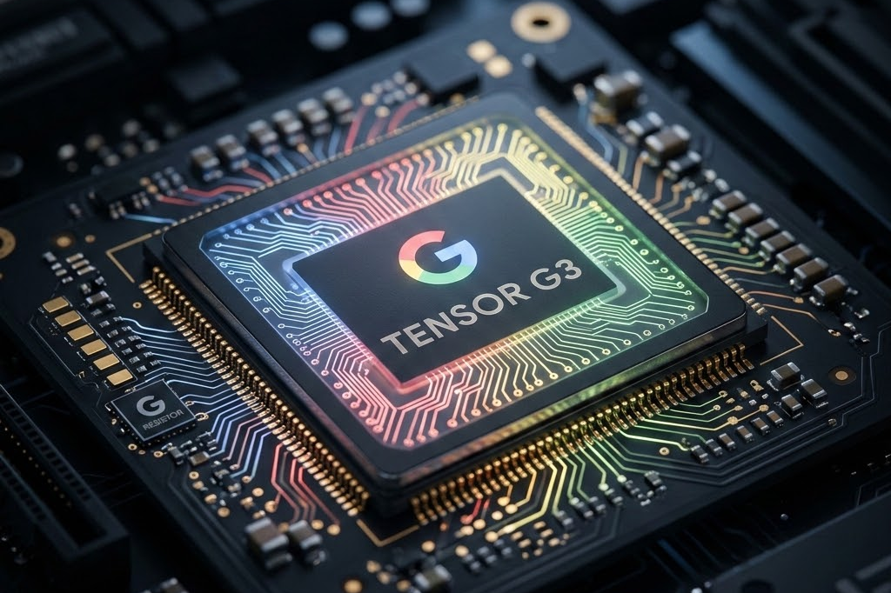
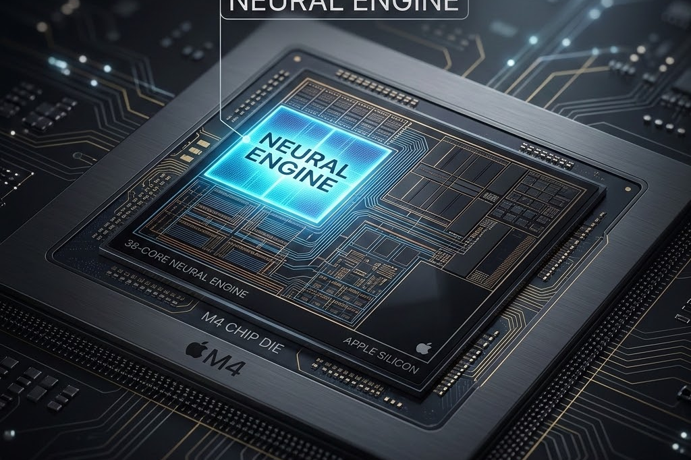
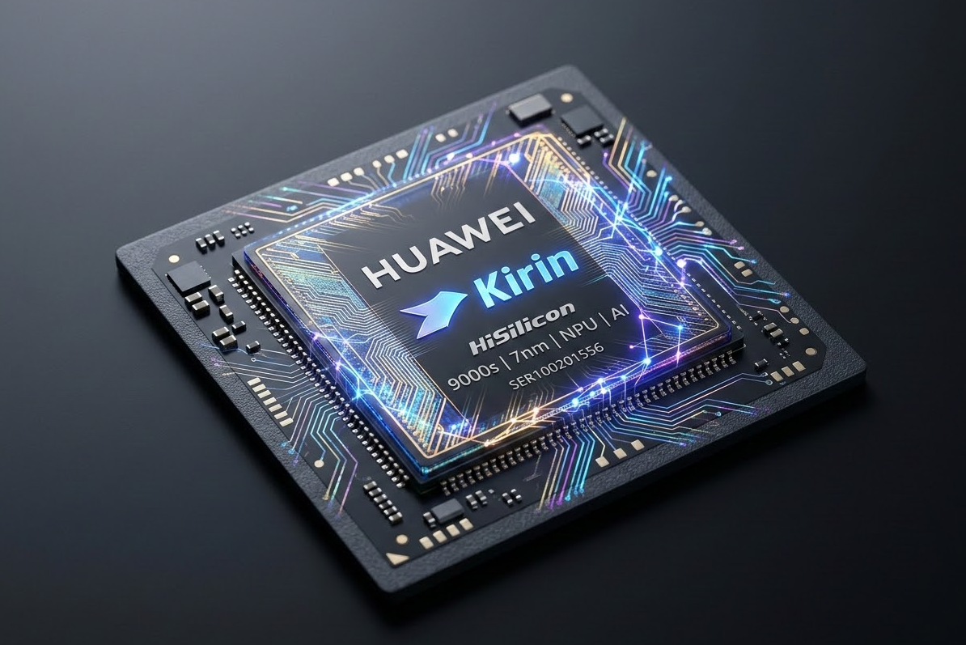
NPUs in Flagship Devices
Dedicated AI silicon powering the next generation of mobile experiences
SAMSUNG
GOOGLE
APPLE
HARMONYOS
Exynos & Snapdragon
Google Tensor TPU
Apple Neural Engine
Huawei Kirin NPU
Powering Galaxy AI features like live translation and generative photo editing.
Drives Magic Eraser, Real Tone, and on-device speech recognition for Pixel devices.
The backbone of FaceID, Siri, and computational photography on iPhone.
Powers cross-device AI collaboration and real-time scene recognition in HarmonyOS.

Slide 5

WebNN
The "Bridge" between your browser and on-device hardware
WebNN enables websites to talk directly to your computer's local "brain" for high-performance AI results.
NPU (Neural Processing Unit)
GPU (Graphics Processing Unit)
CPU (Central Processing Unit)
Result: Instant AI without cloud dependency.

Slide 6

WebNN : Unlocking
Unlocking the full potential of on-device AI hardware for the web.
SPEED
Ultra-Low Latency
Executes ML models directly on local silicon, removing round-trip delays to the cloud.
SECURITY
Privacy by Design
Sensitive user data never leaves the device, ensuring enterprise-grade data sovereignty.
EFFICIENCY
Energy Optimization
Offloads heavy compute to dedicated NPUs, significantly extending mobile battery life.

Slide 7
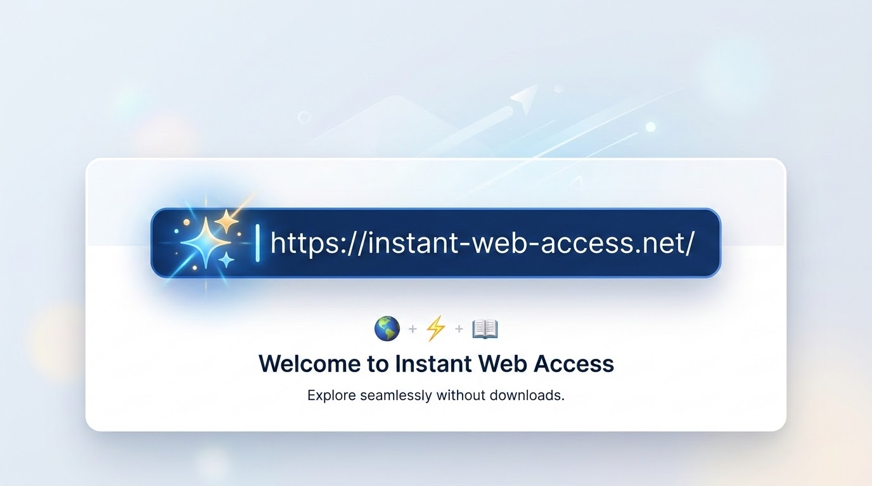
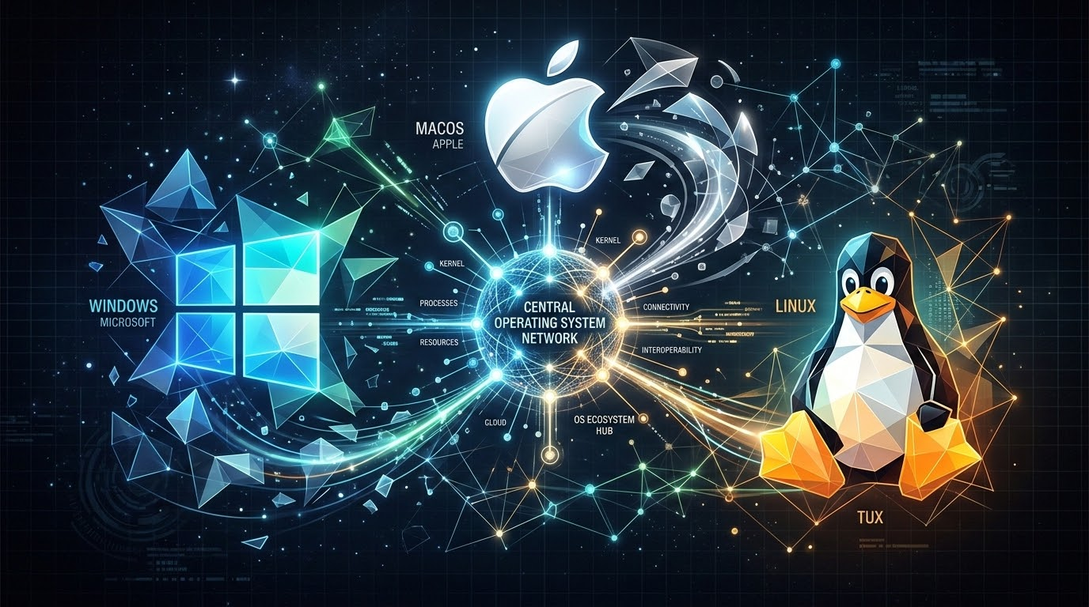

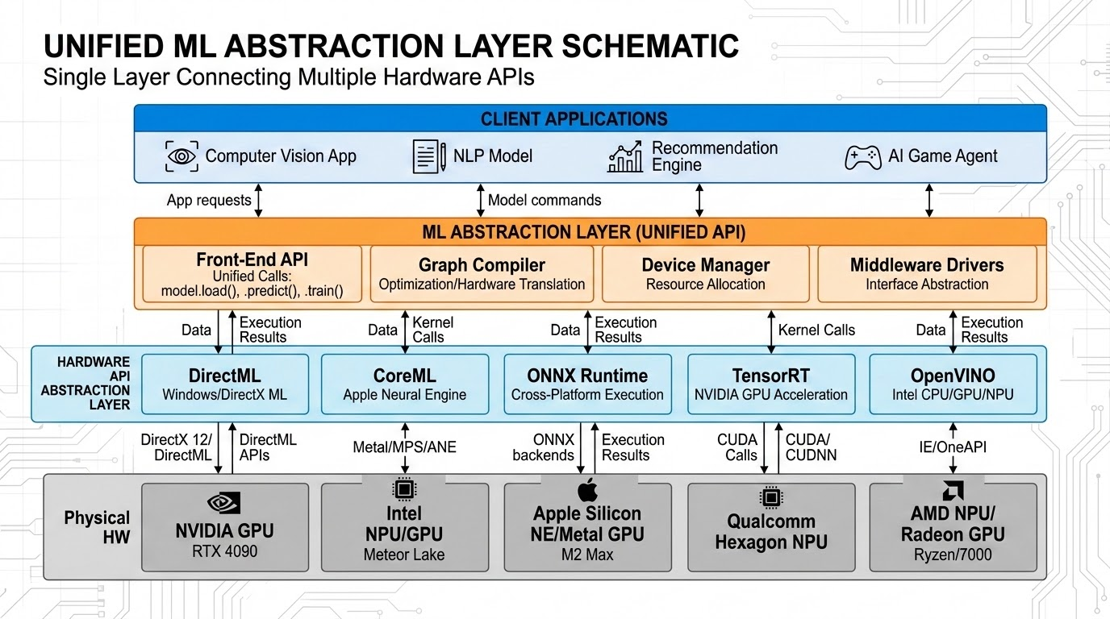
Benefits Over Standalone Native ML Models
Solving the friction of traditional app-bundled AI deployments
ACCESS
SCALE
UPDATES
UNIFIED
Zero Friction
Users run advanced AI instantly via URL, avoiding large, untrusted installation files.
Cross-Platform
Single JavaScript implementation runs across Windows, macOS, Android, and Linux.
Instant Sync
Remote server updates deliver the latest AI logic to all users upon a simple page refresh.
OS Abstraction
Acts as a universal translation layer for DirectML, CoreML, and OpenVINO APIs.

Slide 8
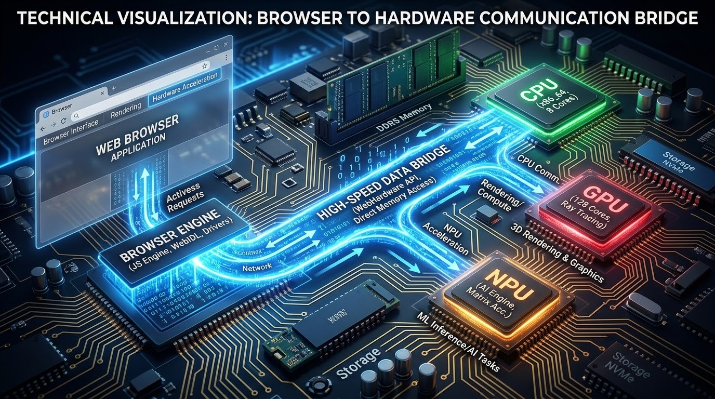
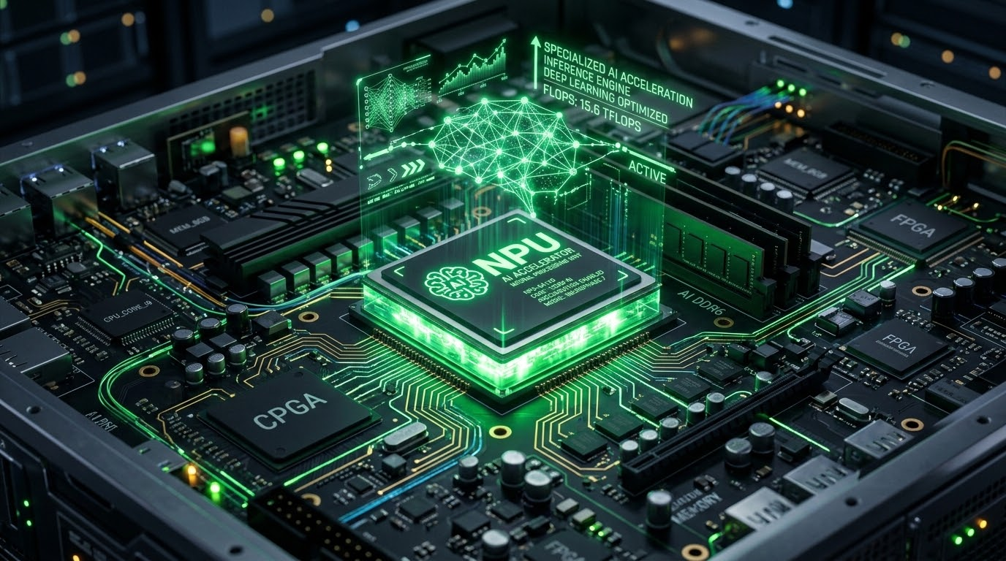


Benefits Over Standard Web ML Frameworks
Bypassing CPU/WASM bottlenecks for near-native performance
ACCESS
ACCELERATION
POWER
THROUGHPUT
Direct Hardware Access
WebNN talks to native OS APIs like DirectML, CoreML, or Android NNAPI. (via Browser’s privileged process)
NPU Unlocked
Standard web engines cannot natively use NPUs. WebNN enables high-efficiency, low-power AI processing.
Massive Efficiency
Offloading tasks to dedicated NPUs drastically reduces battery drain during continuous web AI operations.
Native Speed
Optimized math operators like matrix multiplication run at near-native speeds inside the browser.

Slide 9

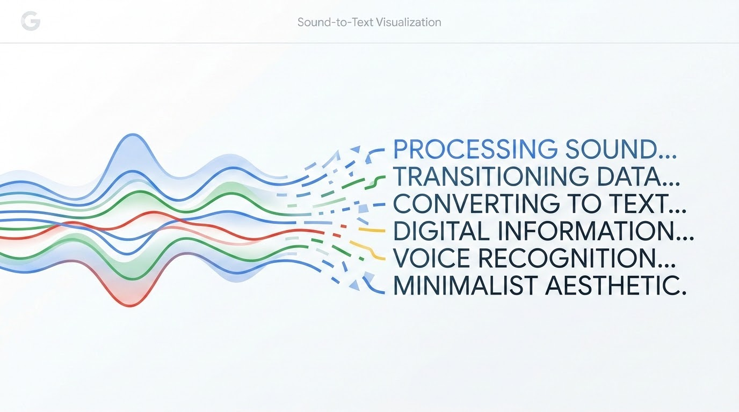


WebNN Usage Scenarios
Transforming web experiences with native hardware acceleration
VISION
AUDIO
MEDIA
CREATIVE
Face & Gesture
Real-time background blur, face tracking, and gesture control for video conferencing.
Speech Coding
High-quality noise suppression and real-time local transcription for private meetings.
Super Resolution
Upscaling low-resolution images and videos directly in the browser using NPU power.
Generative AI
On-device Stable Diffusion or LLM execution for fast, private content creation.

Slide 10
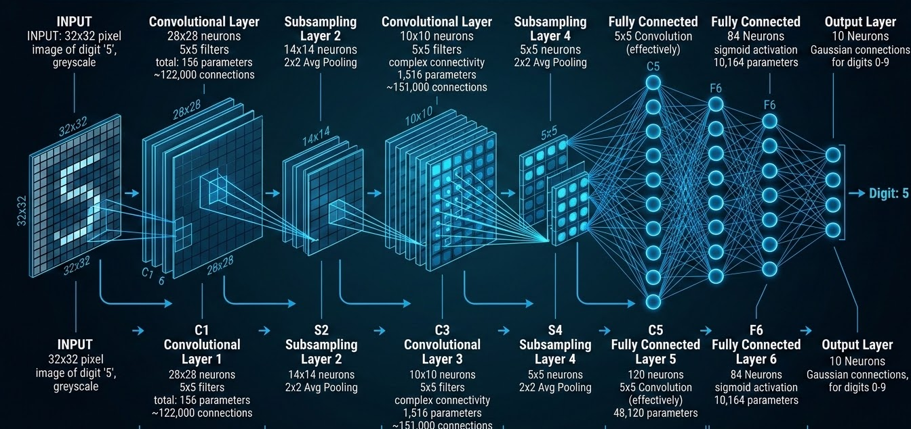

WebNN in Servo
High-performance neural network inference in the Servo web engine
SAMPLES
FACE RECOGNITION
LeNet Handwritten Digit Recognition
Running classical CNN models like LeNet in Servo via WebNN, enabling fast and efficient character recognition directly in the engine.
Real-time Biometric Analysis
Leveraging hardware acceleration for face detection and recognition samples, showcasing Servo's capability to handle complex vision tasks.

Slide 11
Servo Architecture Components for WebNN
WebNN Implementation with LiteRT Backend Architecture Overview
FRONTEND
SERVO-WEBNN CRATE
JavaScript (WebNN API)
DOM Bindings
• MLGraphBuilder • MLContext.dispatch • MLTensor
components/script/dom/webnn/ (~3,069 lines)
Phase 1: Pre-processing
insert_nhwc_transposes()
NCHW → NHWC Conversion
LiteRT Backend
Execution Provider
Compiles and runs via litert-sys FFI bridge.
litert.rs (~515 lines)
Phase 2: Optimization
eliminate_transpose_pairs()
Redundant TRANSPOSE removal
Compiler Engine
GraphNode[] → TFLite flatbuffer
compiler.rs (~2,800 lines)
components/webnn/ (~4,200 lines total)

Slide 12

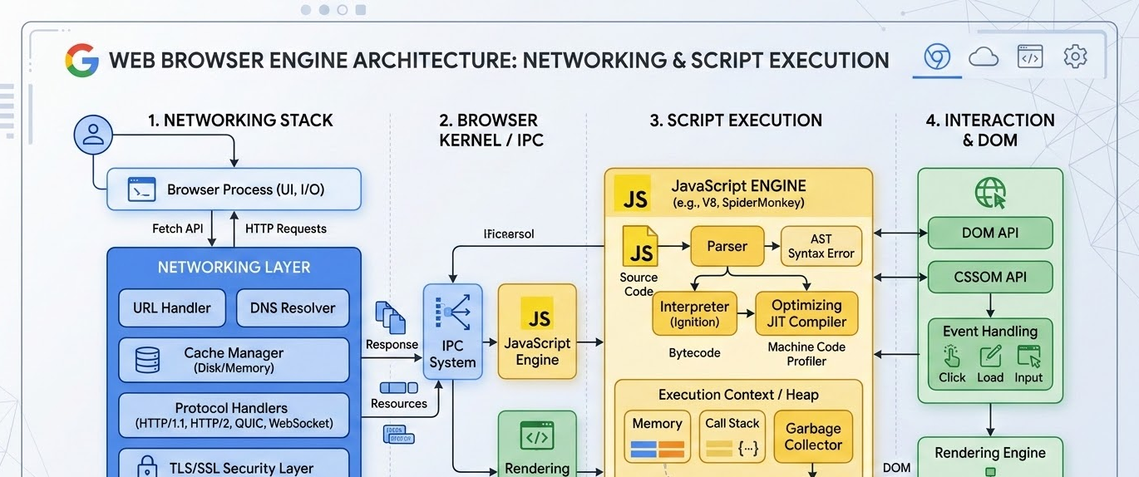
Similar Projects
Exploring related neural network implementations in Rust and Servo
RUST ECOSYSTEM
SERVO FORK
RustNN
github.com/rustnn
A multi-project workspace for W3C WebNN implementation, providing a core Rust library, ONNX utilities, and language bindings.
Servo/WebNN Experiment
github.com/gterzian/servo/tree/webnn
Primary integration branch for WebNN API support within the Servo browser engine, targeting native performance.

Slide 13

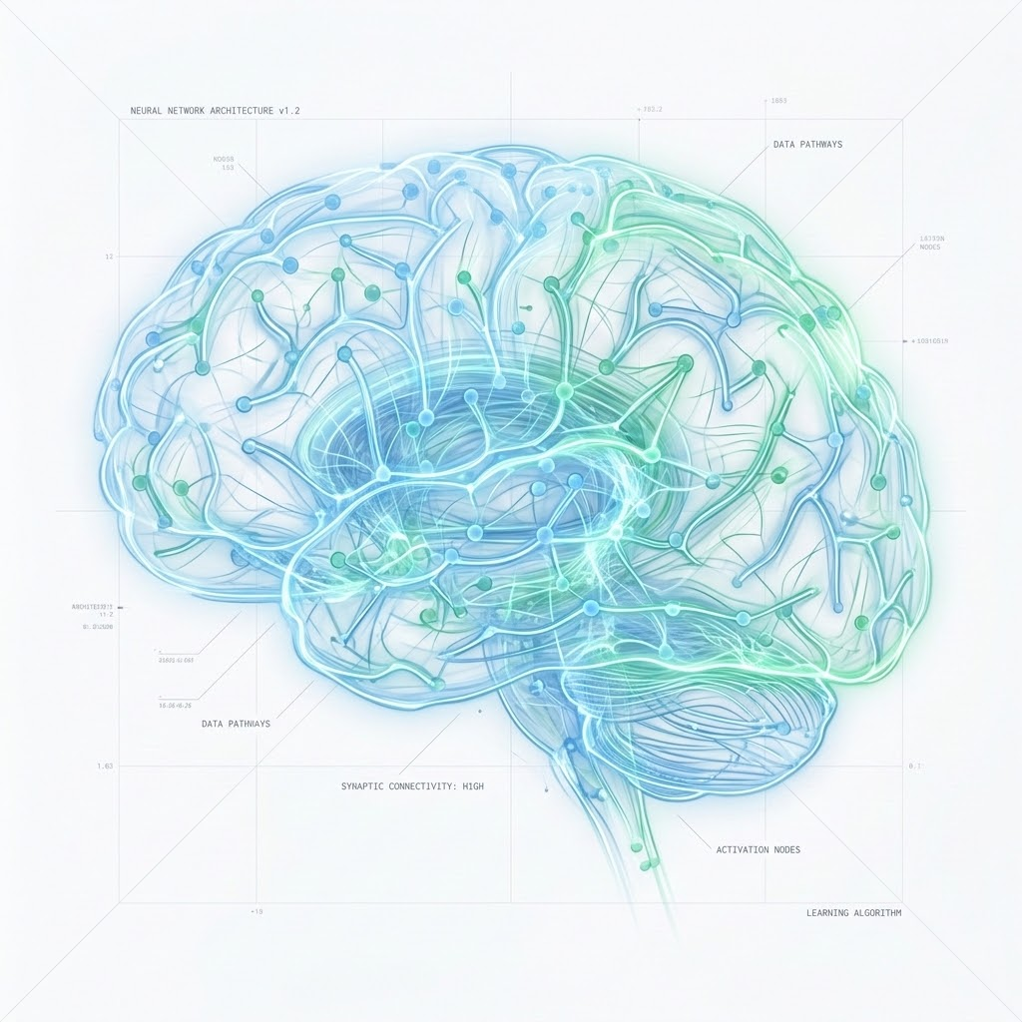



Thank You
Advancing Web AI with Rust
Contact & Contribution
gupta.shubham@huawei.com
github.com/shubhamg13
linkedin/in/shubhamg13
shubham.gupta@chromium.org

